Slide 1
K4P Using data, evidence and research to inform policy decisions
Marko Vujicic, PhD
Chief Economist & Vice President
Health Policy Institute

Slide 2
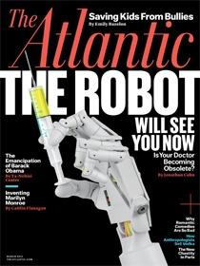
Big Data
The next big thing to hit medical care will be new ways of accumulating, processing, and applying data—revolutionizing medical care the same way Billy Beane and his minions turned baseball into “moneyball.” .

Slide 3
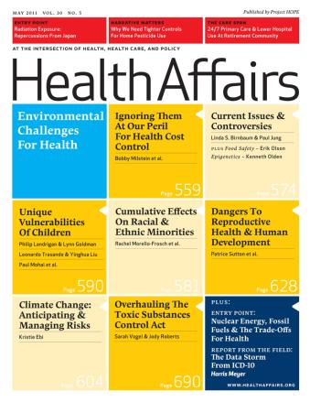
Big Data
Health care data needs a “Henry Ford” moment to move from a realm of unconnected and unwieldy data to a world of connected and matched data with a common support for licensing, legal, and computing infrastructure.
Physicians, researchers, and policymakers should be able to access linked databases of medical records, claims, vital statistics, surveys, and other demographic data.

Slide 4
Agenda
What is K4P?
Using evidence to guide…
Dental care use
Provider shortage assessment
Medicaid expansion
‘Value-to-volume’ transition
Role of the dental practice
Priorities for data and evidence

Slide 5
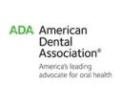
About Me

Slide 6
What is K4P?
Generating, synthesizing, and contextualizing evidence so that it is useful in guiding policy making.

Slide 7
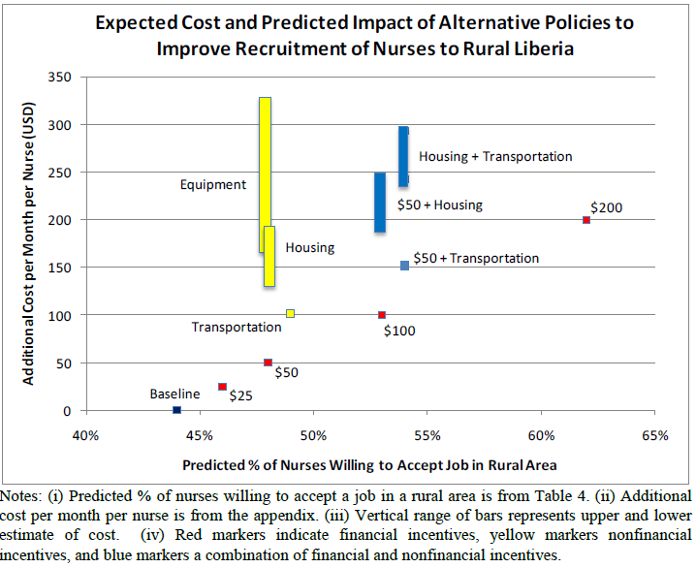
K4P in Liberia
Notes:
The Center for Professional Success, which will soon be launched, is an example of a new member benefit specifically aimed at helping dentists run more efficient practices.
The ADA is doing a comprehensive study of group practices to better inform our members of the various practice environments out there.
Our Health Policy Resources Center is also already engaging in new analysis to understanding oral care seeking behavior among young adults.

Slide 8
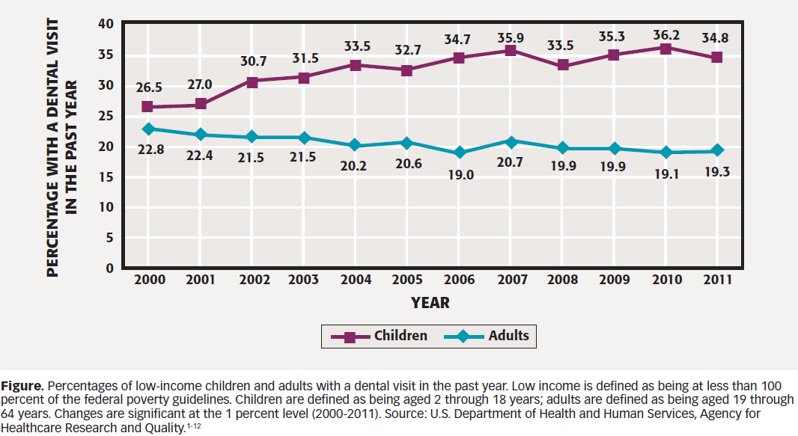
Dental Care Use

Slide 9
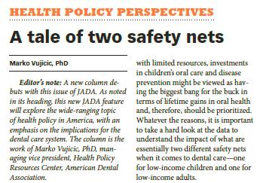
Dental Care Use

Slide 10
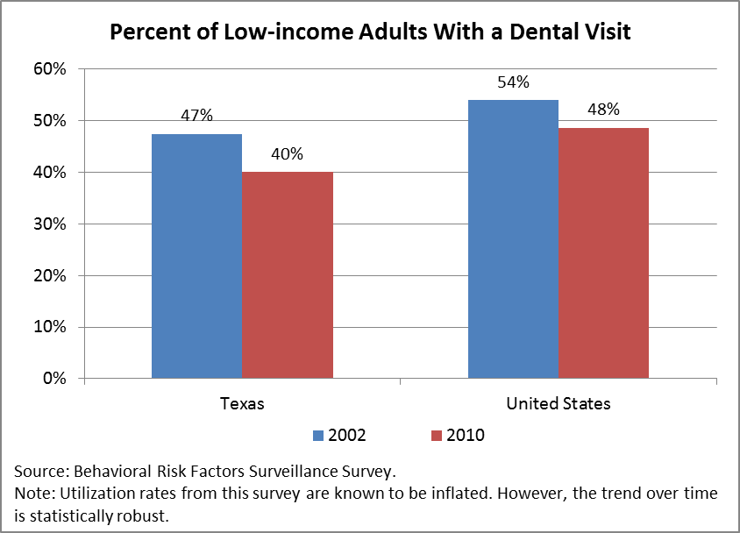
Dental Care Use

Slide 11
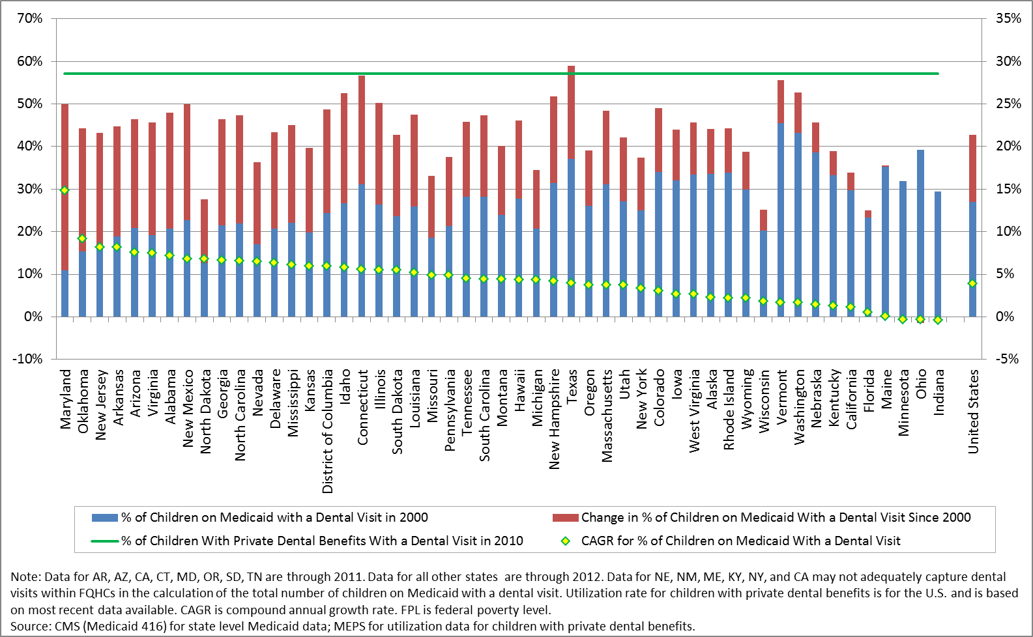
Dental Care Use

Slide 12
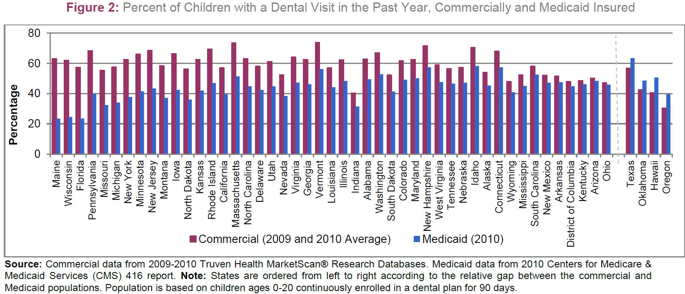
Dental Care Use
Notes:
Emergency room use for dental conditions is increasing. Dental visits in ERs in the US doubled from 1 million in 2000 to 2 million in 2010.
This increase is being driven entirely by rising rates among young adults, 21-34.
In fact, 50% of all dental ER visits in the US are accounted for by 21-34 year olds.
This is further evidence of access issues among young adults

Slide 13
Medicaid
Texas, Maryland, Connecticut made improvements to their Medicaid program in recent years and saw impressive gains in access to care
Beazoglou T, J Douglass , H Bailit, V Myne-Joslin. 2013. Impact of increased dental reimbursement rates on husky a-insured children: 2006-2011. Health Issues Connecticut Health Foundation. February 2013.
Thuku NM, K Carulli, S Costello S, HS Goodman. 2012. Breaking the cycle in Maryland: oral health policy change in the face of tragedy. J Public Health Dent. Suppl 1:S7-13.
Adjusting provider incentives and streamlining administrative process have huge impact
Decker SL. 2011. Medicaid payment levels to dentists and access to dental care among children and adolescents. JAMA. 2011;306(2):187-193.
Buchmueller T, S Orzol, L Shore-Sheppard. 2013. The effect of Medicaid payment rates on access to dental care among children. NBER Working Paper No. 19218.

Slide 14
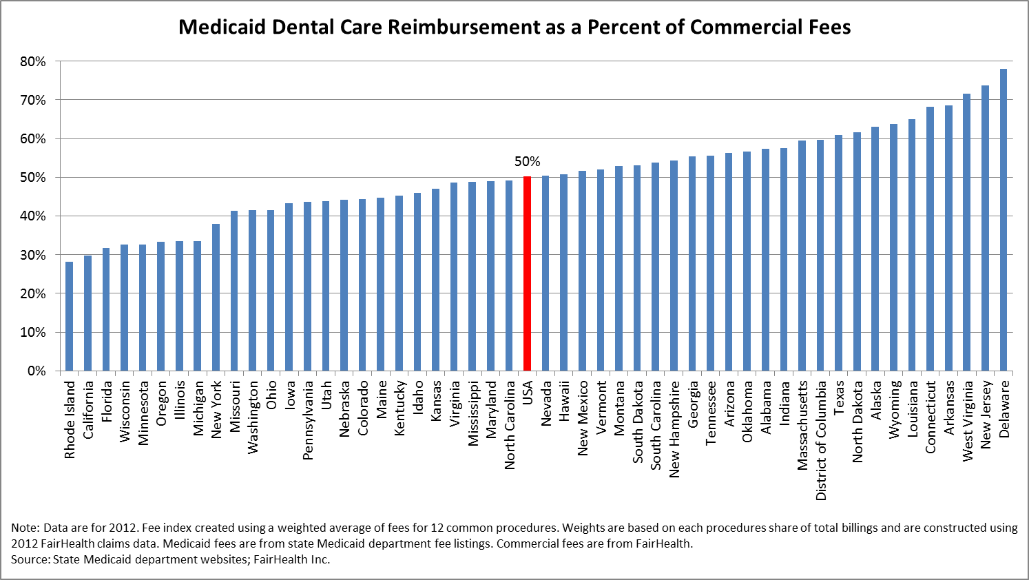
Medicaid
Notes:
The Center for Professional Success, which will soon be launched, is an example of a new member benefit specifically aimed at helping dentists run more efficient practices.
The ADA is doing a comprehensive study of group practices to better inform our members of the various practice environments out there.
Our Health Policy Resources Center is also already engaging in new analysis to understanding oral care seeking behavior among young adults.

Slide 15
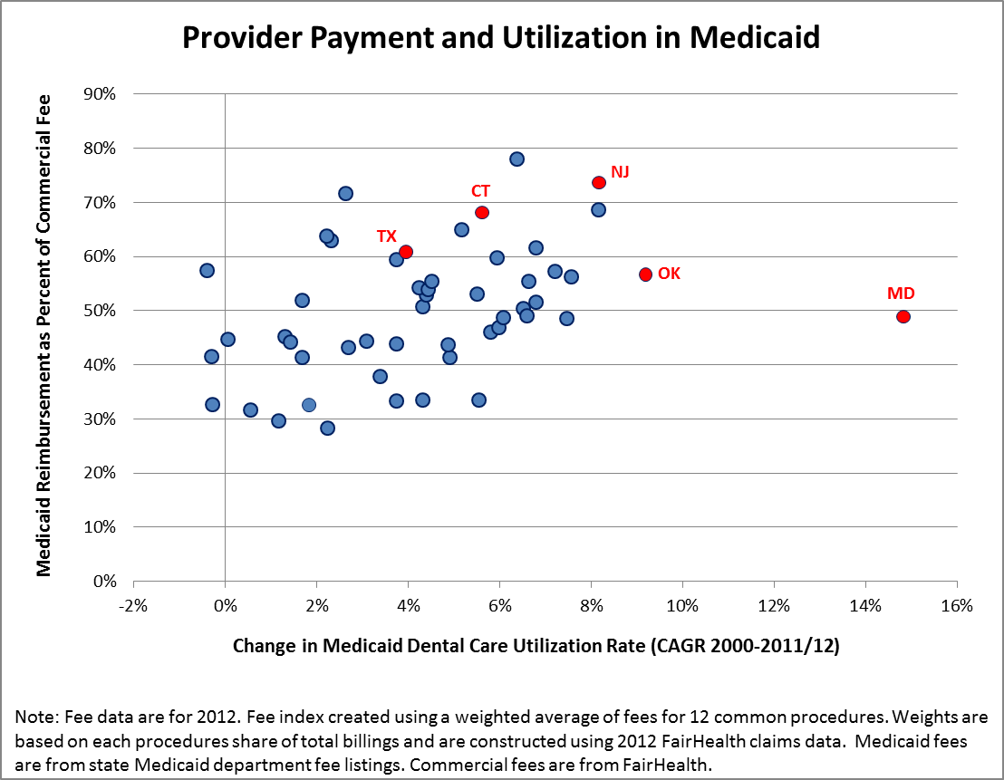
Medicaid
Notes:
The Center for Professional Success, which will soon be launched, is an example of a new member benefit specifically aimed at helping dentists run more efficient practices.
The ADA is doing a comprehensive study of group practices to better inform our members of the various practice environments out there.
Our Health Policy Resources Center is also already engaging in new analysis to understanding oral care seeking behavior among young adults.

Slide 16
Innovative Client Engagement in Medicaid
Connecticut: A dental healthcare specialist works individually with clients to overcome their barriers to care.
Mississippi: Program offers an incentive to clients for following through on appointments and for children for having their screenings completed.
Virginia: A pilot project assigns clients to a dental home. Educational material is distributed and members are available to speak directly with clients.

Slide 17
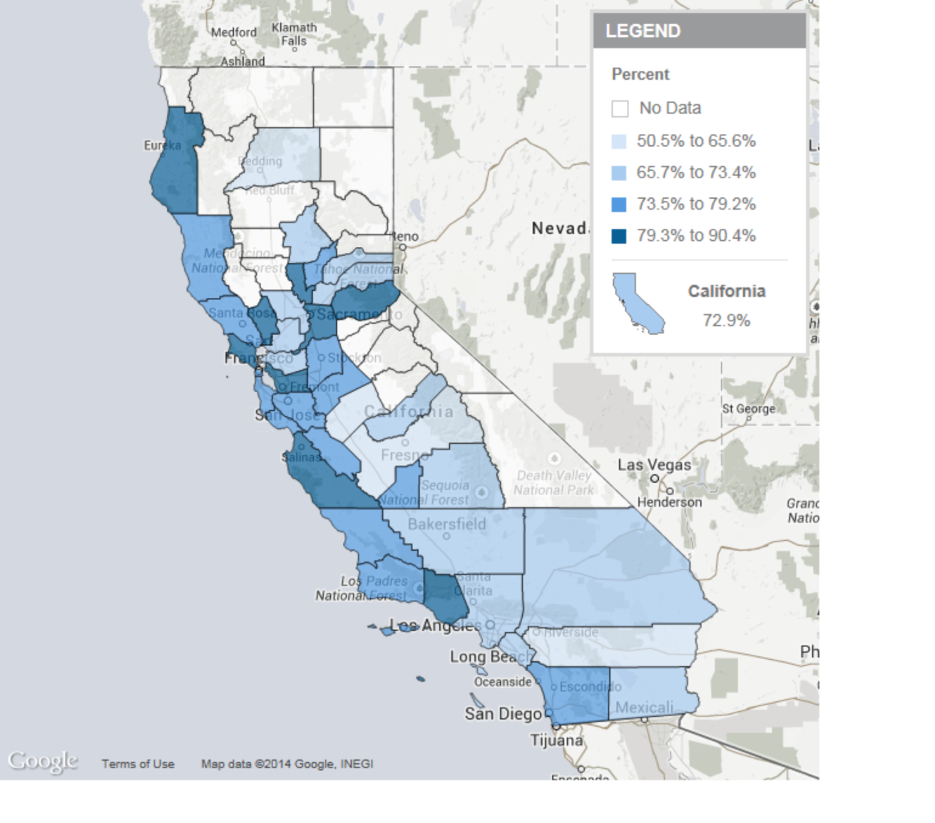
Length of Time Since Last Dental Visit: 2011-2012
(Length of Time Since Last Dental Visit: Less than 6 months ago; Age Group: Ages 2-11)
Definition: Estimated percentage of children ages 2-17, by length of time since their last dental visit and by age group.
Data Source: As cited on kidsdata.org, UCLA Center for Health Policy Research, California Health Interview Survey. Accessed at http://www.chis.ucla.edu/ (Aug. 2013).

Slide 18
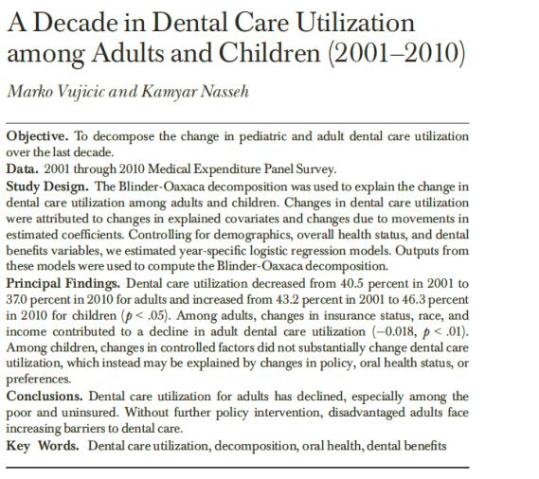
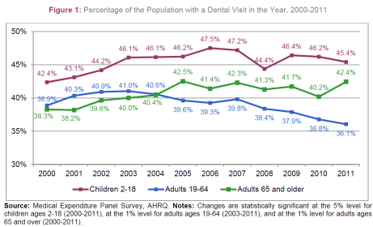
Why is Adult Dental Care Use Falling?

Slide 19
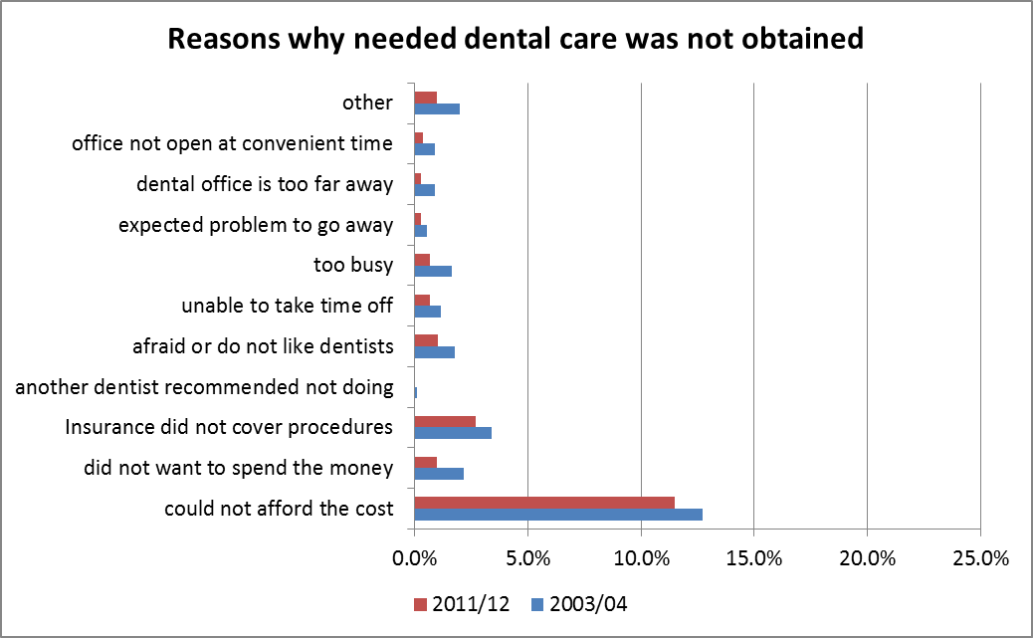
Barriers to Dental Care Use

Slide 20
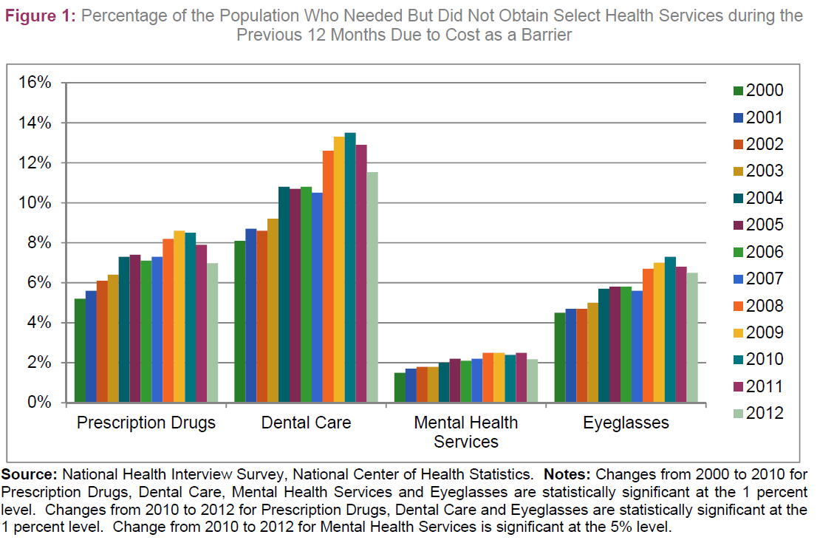
Dental Care Use – Cost Barriers

Slide 21
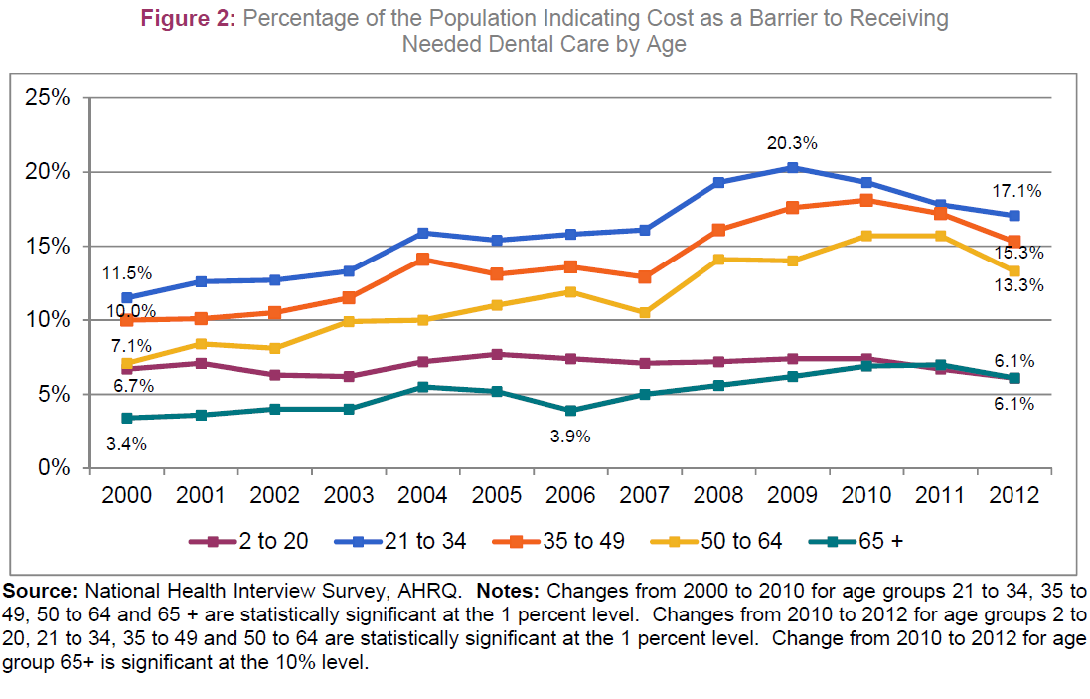
Dental Care Use – Cost Barriers

Slide 22
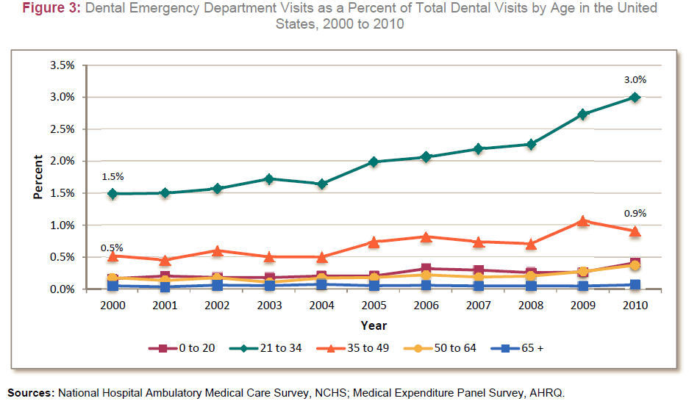
Dental Care Use - ERs
?
?

Slide 23
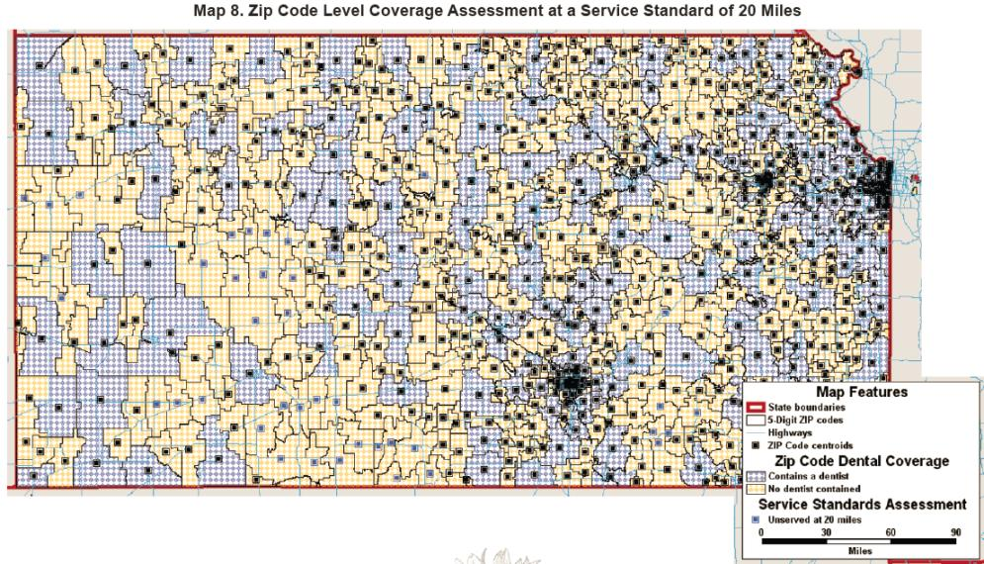
Provider Shortage Assessment

Slide 24
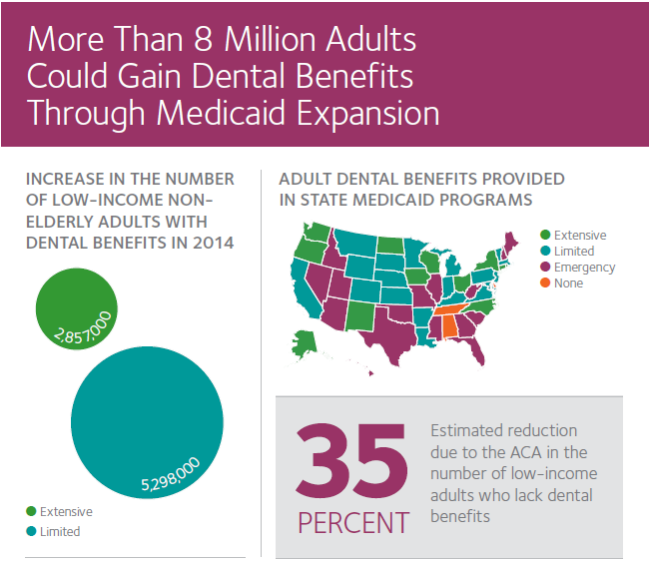
Medicaid Expansion
15% of general dentists
50% of pediatric dentists
are accepting new Medicaid patients

Slide 25
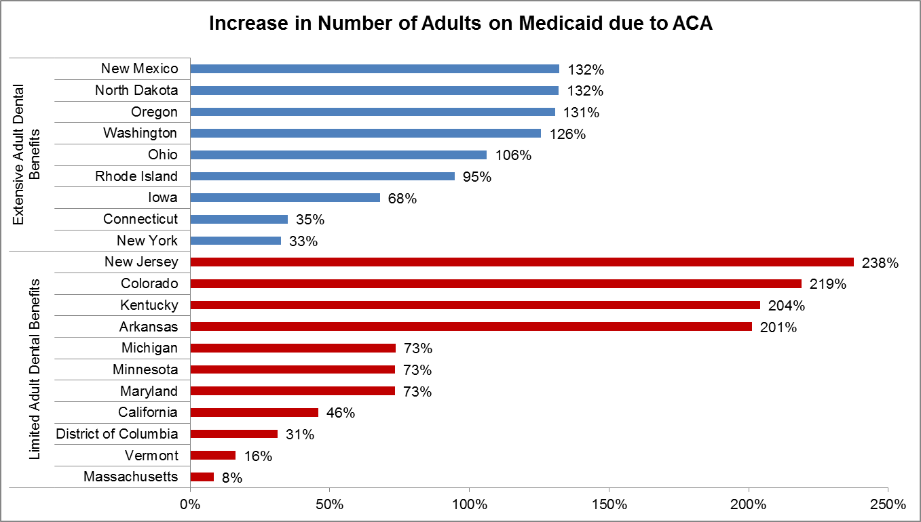
Medicaid Expansion
Source: ADA Health Policy Resources Center analysis of State Medicaid Policies, Kaiser Family Foundation. Notes: We examined the Medicaid benefits offered by each state to determine the type of dental benefits provided to enrolled adults. States typically post benefits information on their state Medicaid website, or in a statement of benefits. We classified each state’s adult Medicaid dental benefits into one of four categories: extensive dental benefits, limited dental benefits, emergency dental benefits, and no dental benefits. While there is no clearly defined, well-established method for classifying adult Medicaid dental benefits, these categories are consistent with previous methodology developed by the ADA. We calculated the potential percentage change in adults eligible for Medicaid by dividing the number of adults potentially eligible for Medicaid in 2014 as determined by the Kaiser Family Foundation by the number of adults enrolled in Medicaid in 2010, by state.

Slide 26
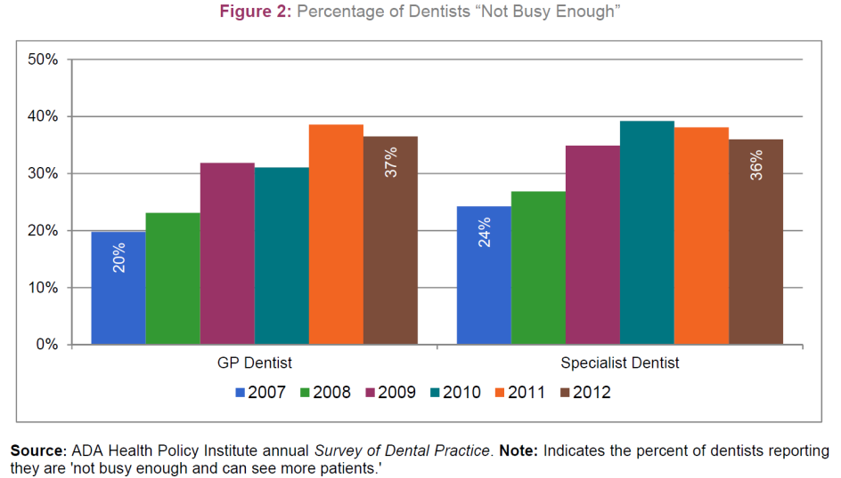
Making the Medicaid Expansion Work

Slide 27
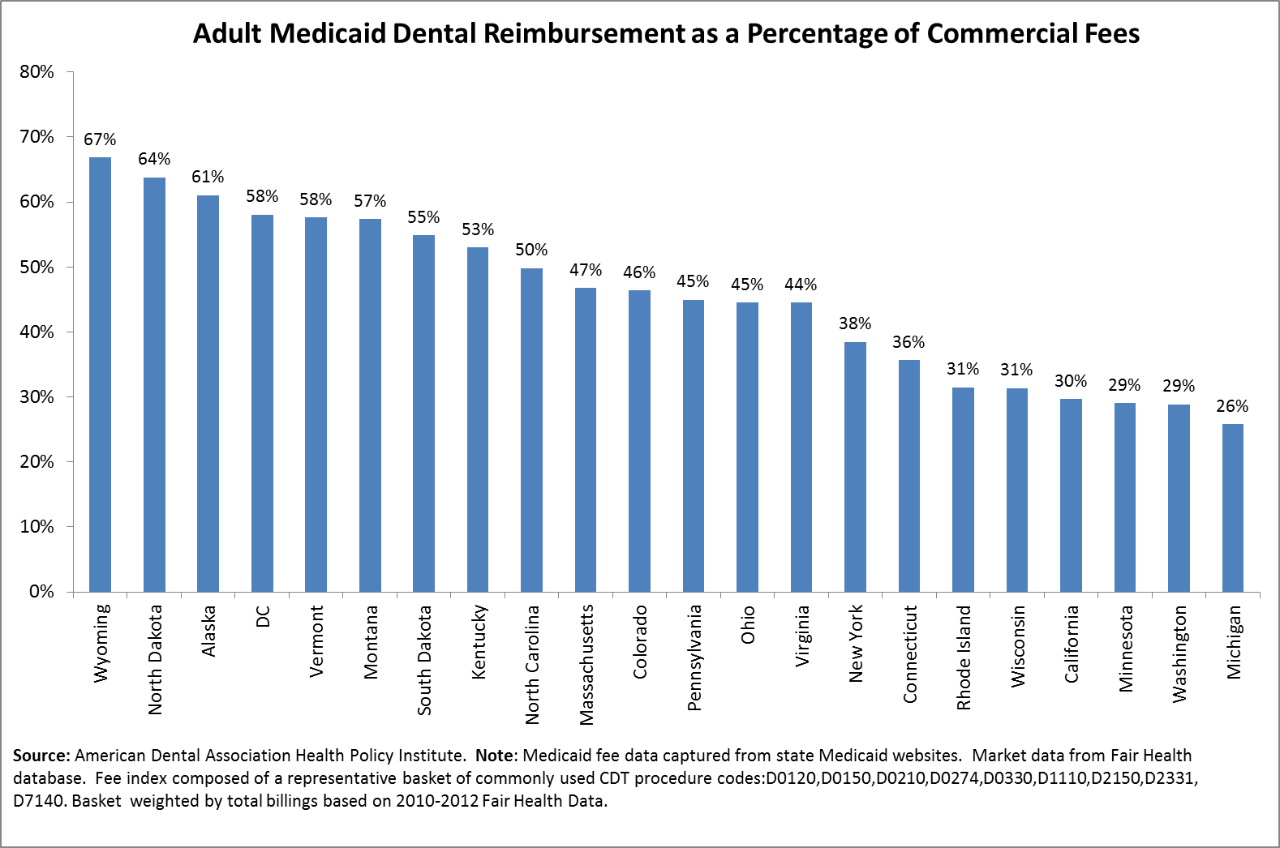
Making the Medicaid Expansion Work
Notes:
The Center for Professional Success, which will soon be launched, is an example of a new member benefit specifically aimed at helping dentists run more efficient practices.
The ADA is doing a comprehensive study of group practices to better inform our members of the various practice environments out there.
Our Health Policy Resources Center is also already engaging in new analysis to understanding oral care seeking behavior among young adults.

Slide 28
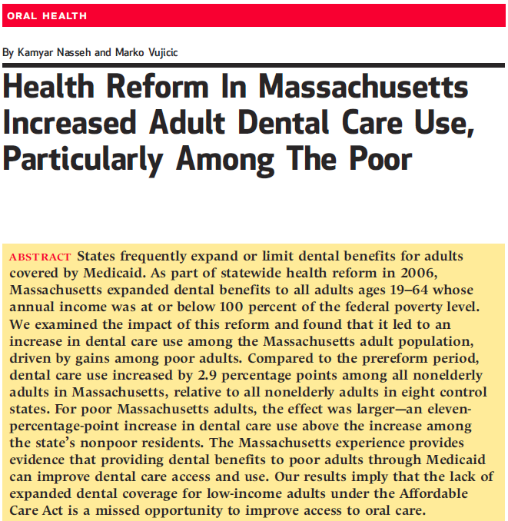
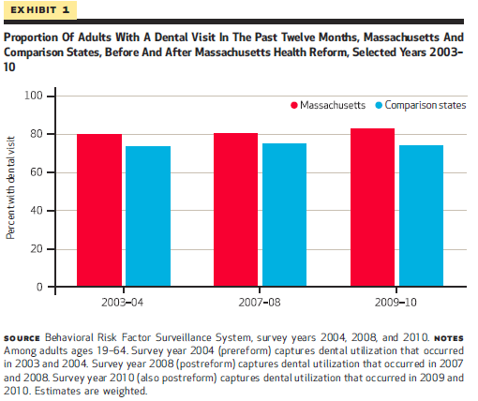
Making the Medicaid Expansion Work

Slide 29
Making the Medicaid Expansion Work
Promote Solutions that Create ‘Enabling Conditions’ in Medicaid Programs
Reduce administrative burdens
Increase patient and provider outreach
Implement appropriate provider incentive structure
Promote fair and reasonable program integrity initiatives
Provide Practical Tools to Help Dentists Succeed
Design a suite of CE products for Medicaid-interested providers
Provide support services (e.g. call center, FAQs, mentors)
Synthesize and disseminate ‘best practices’ for various types of dental practices participating in Medicaid

Slide 30
Emphasis on Value
“Providers should be required to measure…improvements in quality of life, functioning and longevity.
After a patient has a knee replaced, can she walk normally? When a child has asthma can he play school sports? Unfortunately, the measurements we use today leaves us unable to make many of these vital judgments about the quality of doctors, hospitals or health care organizations.”
David Lansky, CEO, Pacific Business Group on Health, speaking on behalf of Boeing, Target, Disney, Wal-Mart, Intel, GE, Wells Fargo and the California Public Employees Retirement System.

Slide 31
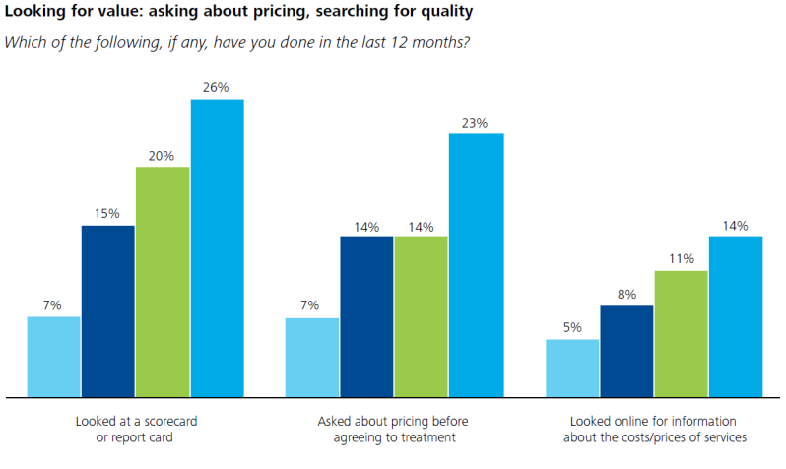
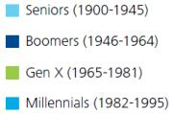
Emphasis on Value
Notes:
Emergency room use for dental conditions is increasing. Dental visits in ERs in the US doubled from 1 million in 2000 to 2 million in 2010.
This increase is being driven entirely by rising rates among young adults, 21-34.
In fact, 50% of all dental ER visits in the US are accounted for by 21-34 year olds.
This is further evidence of access issues among young adults

Slide 32
Emphasis on Value
Notes:
Emergency room use for dental conditions is increasing. Dental visits in ERs in the US doubled from 1 million in 2000 to 2 million in 2010.
This increase is being driven entirely by rising rates among young adults, 21-34.
In fact, 50% of all dental ER visits in the US are accounted for by 21-34 year olds.
This is further evidence of access issues among young adults

Slide 33
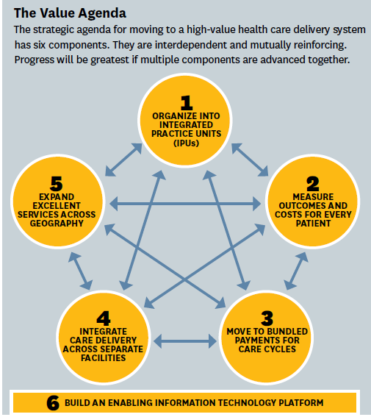
Making the Value Agenda Work
Notes:
Emergency room use for dental conditions is increasing. Dental visits in ERs in the US doubled from 1 million in 2000 to 2 million in 2010.
This increase is being driven entirely by rising rates among young adults, 21-34.
In fact, 50% of all dental ER visits in the US are accounted for by 21-34 year olds.
This is further evidence of access issues among young adults

Slide 34
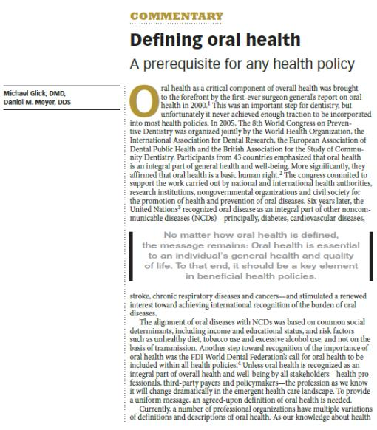
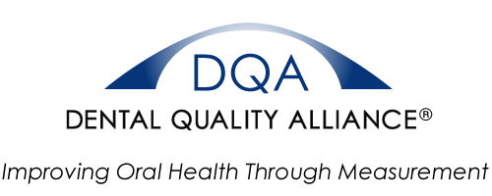
Making the Value Agenda Work
Notes:
Emergency room use for dental conditions is increasing. Dental visits in ERs in the US doubled from 1 million in 2000 to 2 million in 2010.
This increase is being driven entirely by rising rates among young adults, 21-34.
In fact, 50% of all dental ER visits in the US are accounted for by 21-34 year olds.
This is further evidence of access issues among young adults

Slide 35
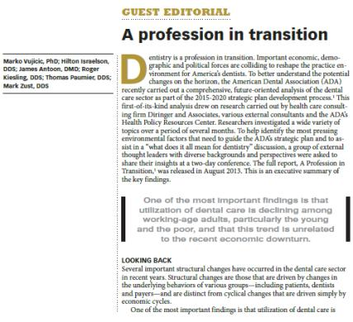
The Role of the Dental Practice
Tomorrow’s health care environment will provide an opportunity to re-examine the role of oral care providers within the health care system.

Slide 36
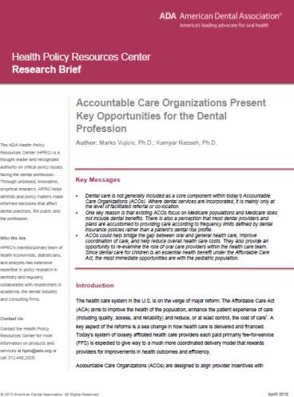
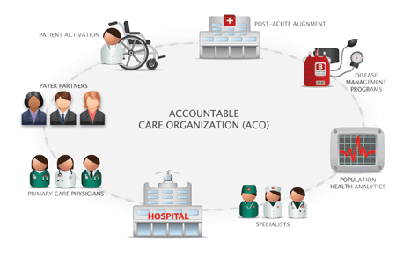
The Role of the Dental Practice
Notes:
Emergency room use for dental conditions is increasing. Dental visits in ERs in the US doubled from 1 million in 2000 to 2 million in 2010.
This increase is being driven entirely by rising rates among young adults, 21-34.
In fact, 50% of all dental ER visits in the US are accounted for by 21-34 year olds.
This is further evidence of access issues among young adults

Slide 37
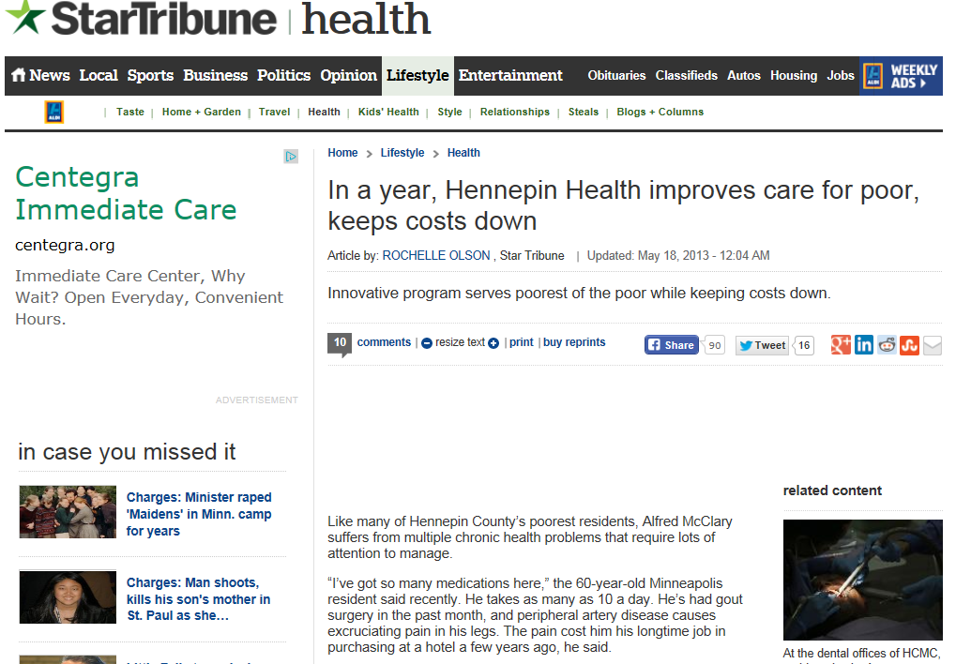
The Role of the Dental Practice
Notes:
Emergency room use for dental conditions is increasing. Dental visits in ERs in the US doubled from 1 million in 2000 to 2 million in 2010.
This increase is being driven entirely by rising rates among young adults, 21-34.
In fact, 50% of all dental ER visits in the US are accounted for by 21-34 year olds.
This is further evidence of access issues among young adults

Slide 38
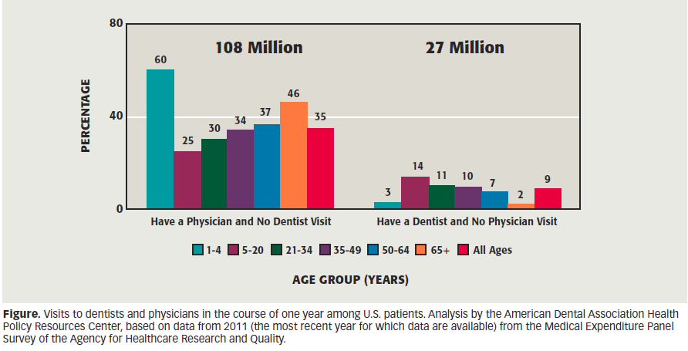
The Role of the Dental Practice

Slide 39
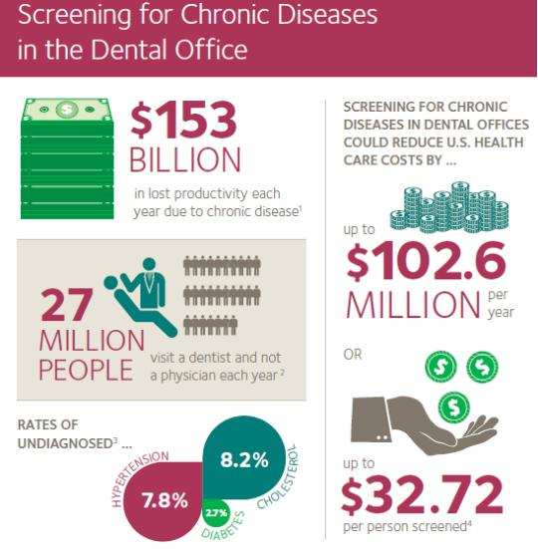
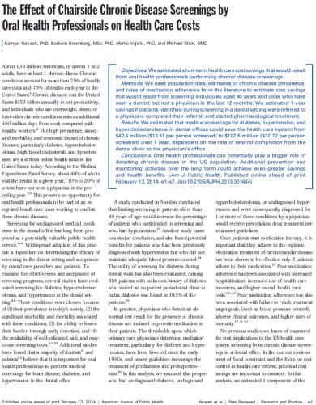
The Role of the Dental Practice

Slide 40
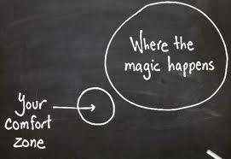
Thank You!
For more information visit the ADA Health Policy Institute at:
www.ada.org/hpi

